Slide 1
UE19CS390B – Project Phase – 2
END SEMESTER ASSESSMENT
Project Title : Tender Management System using Blockchain
Project ID : 04
Project Guide : Prof. Animesh Giri
Project Team : Sathvik Allundi PES2UG19CS368
Ram Shabarish PES2UG19CS135
Jinka Sagar PES2UG19CS168
Garuda Yochana Sheetal PES2UG19CS126

Slide 2
Outline
Abstract
Summary of Requirements and Design ( Phase - 1)
Summary of Methodology / Approach (Phase - 1)
Design Description
Modules and Implementation Details
Project Demonstration and Walkthrough
Test Plan and Strategy
Results and Discussion
Lessons Learnt
Conclusion and Future Work
References

Slide 3
Abstract
Tender refers to an invitation to bid for a project. Tendering usually refers to the process where governments and financial institutions invite bids for large projects that must be submitted within a finite deadline. It can also refer to the acceptance of a formal offer. So, tenders are very important and must be properly handled. A tender management system tries to solve the problem of offline tender offices where they are requested to submit their bids. Where the information can be tampered, and data manipulation can be done. To overcome this online tender management system are developed. We cannot say that online tender management system are safe anymore as there are lot of cyber attacks going on. To solve this problem, we are building tender management system using blockchain technology. Blockchain technology is a shared, immutable ledger that facilitates the process of recording transactions and tracking assets in a blockchain network. Using this technology, we can make sure that the transactions are not duplicated, and the data is not tampered. This tender management system uses blockchain technology to send their bids to the contractors through blockchain.

Slide 4
Summary of Requirements and Design
Summary of Requirements (A bulleted list of the major requirements.
A background review of the state of the art in the relevant field showing strength and weakness.
Design Approach (Prototype / Product based Projects) along with constraints, dependencies, assumptions and Risks.
Design Details (Research Projects)
Add as many slides as necessary.

Slide 5
Summary of Requirements and Design
Functional Requirements
The functional requirement is a description of the service that the software must offer. It describes a software system or its components. A function is nothing but input to the software system, its behaviour and outputs. It can be specific functionality which defines what function a system is likely to perform. They are also called function specification.
The system should be able to add new tenders to the tenders list
The system should be able to differentiate between the user and the contractor
Add tender function should be allowed only to the contractor or the tender proposer • The system must be able to list the available tenders in real time
The system should be able to bid for a tender
The system should make sure that all details are filled in the bidding form • The system should be able to reject the duplicate bids

Slide 6
Constraints: As of now the application works with only a good internet connection. It is limited to use only in a desktop with a browser compatible with any Ethereum wallet. The performance of the application depends on the chain that the smart contract is deployed or the token that will be used to interact with the system.
Assumptions: For the projects purpose it is being assumed that user knows English for providing text input while filling the form while bidding for a tender. It is also assumed that the user is familiar with basic usage of decentralized application, that is setting up the wallet, accepting the transaction and the gas info.

Slide 7
Dependencies:
reactjs is used to develop the front end.
Smart contract is developed using solidity programming language
Hardhat is used to compile, test and deploy the smart contract
Polygon Mumbai testnet is used for the smart contract testing
Test MATIC is required to interact with the smart contract
Browser compatible with Ethereum wallet
Smart contract and the front end is connected using libraries like ethers,
walletconnect, and openzeppelin

Slide 8
Summary of Methodology / Approach
Research Project
Proposed Methodology
Model Architecture
Details of the approach- benefits/drawbacks
Prototype/Product based Project
Design Approach followed with description and technologies used.
Highlight if there are alternative approaches chosen after phase – 1,explain why, including its advantage.
Add 1 – 2 slides.

Slide 9
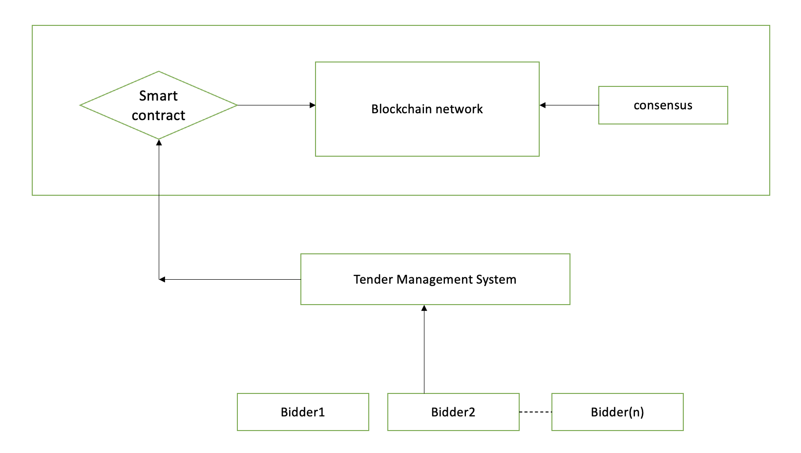
Architecture diagram

Slide 10
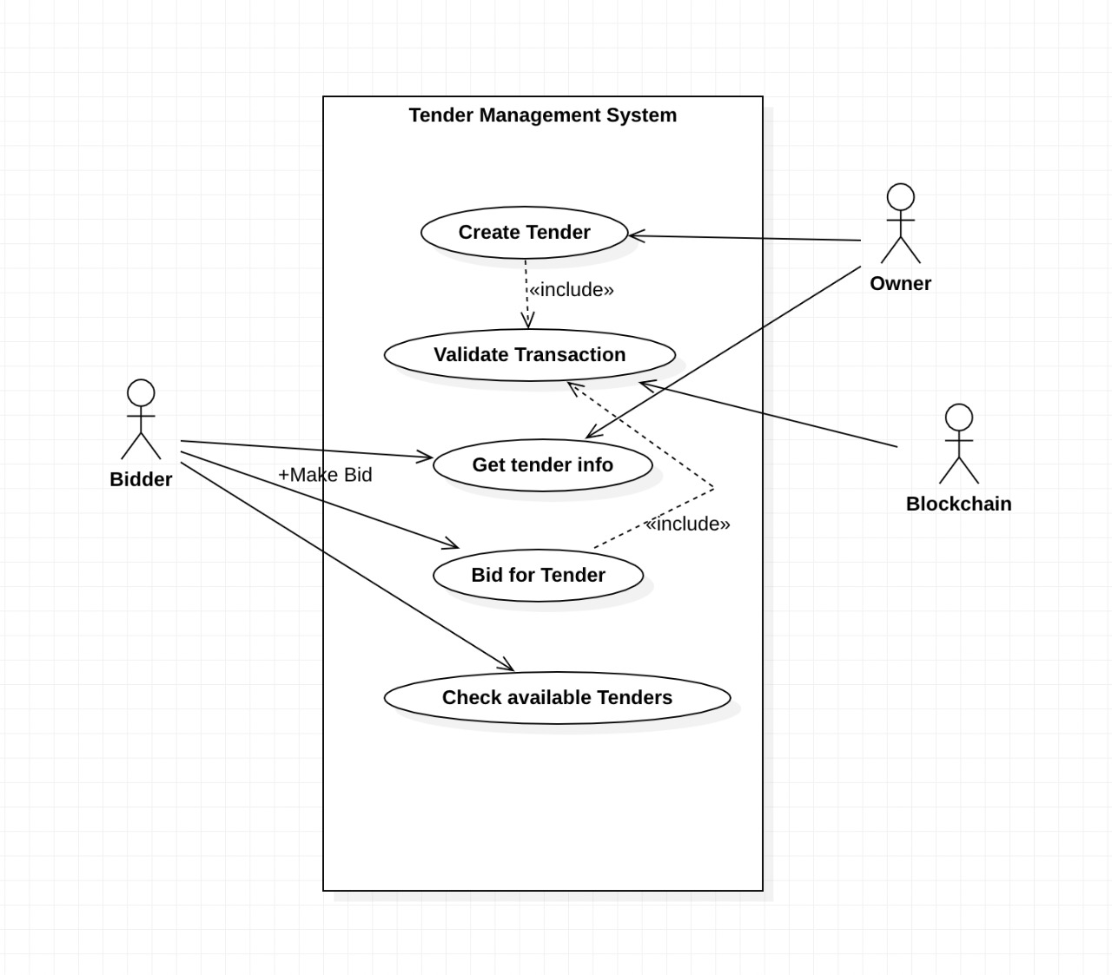
Use case Diagram
The bidder can use the function check available tenders to get the list of all available tenders.
Bid for tender function is used to bid for a particular tender providing the required details
Owner interacts with the system to add new tenders Owner can use the get tender info function to check the number of bids for a
particular tender

Slide 11
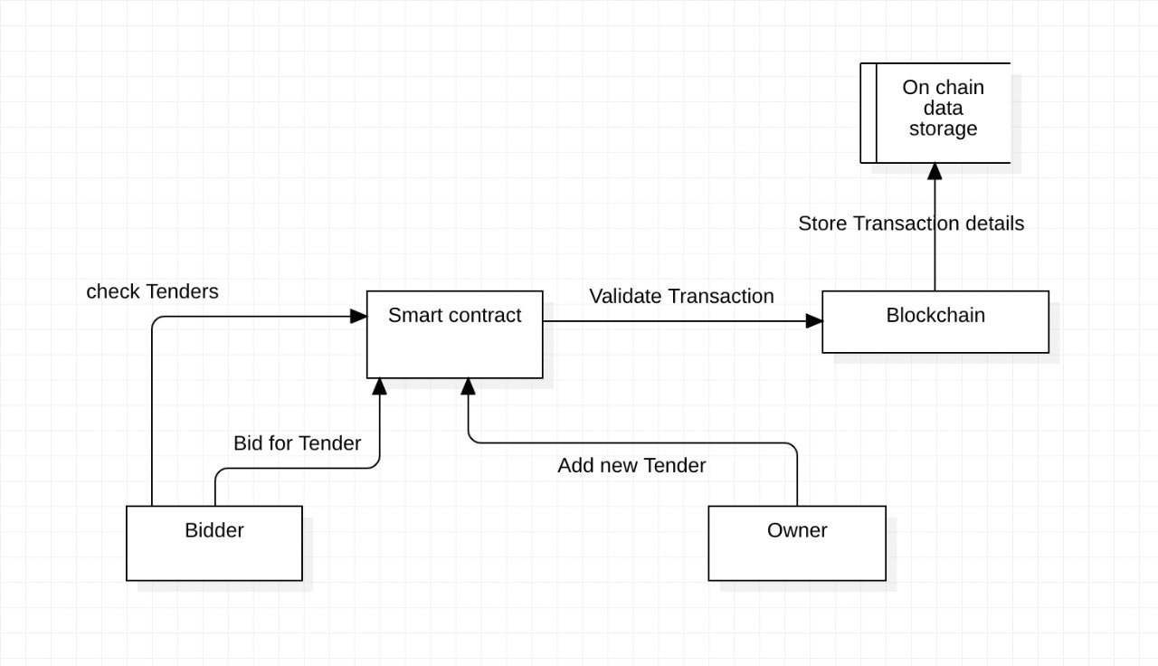
Data flow diagram

Slide 12
Modules and Implementation Details
Add tender: The add tender function is responsible for adding new tenders to the list of all available tenders which the bidder can use to bid for the tender they want to. This function can clearly differentiate the users and the contractor. The contractor here is the one who is hosting the system intending to get bids for the proposed tenders. The function will only allow the contractor to add new tenders.

Slide 13
2. Bid for tender: This function enables the users of the bidders to bid for the tender they want to. The tenders available are in a list which contains all the tenders that are available for bidding. This function takes necessary information for the process of bidding it takes, name of the organization, organization email, organizations phone, proposed bid in string, and proposed bid in number. The function warns to fill all the fields mentioned above.

Slide 14
3) Smart contract: This is responsible for the validation of the two functions add tender and bid for tender. The smart contract makes sure only contractors will be able to add new tenders and it makes sure that a single organization cannot bid for a tender more than one, to prevent duplicate bids from the same organization.

Slide 15
Project Demonstration

Slide 16
Walkthrough
Demo and Product walk thru

Slide 17
Test Plan and Strategy
Unit testing done for every function
All the functions were tested during the development phase
Testing has been done post deployment to the polygon network

Slide 18
Test Plan and Strategy
Case1: Add new tender by owner
Case2: Add new tender by others
Case3: Submit tender
Case4: Submit tender twice
Case5: Get number of submissions for every tender
Case6: Get which tenders are available

Slide 19
Result and discussion
The smart contract is able to differentiate between owner(Person who has deployed the smart contract) and other clients.
The smart contract will give an error if others tries to add any new tender.
The smart contract will accept the tender of a legitimate bid.
The smart contract will give an error if a bidder tries to duplicate the bids.
It will store the number of bids done for every tender.
It will store the tender in a list format it can be accessed by giving in the indexes.

Slide 20
Documentation
Show the evidences, status of the below documents:
Project report submitted in department?
Yes,
IEEE (similar) Format of Paper current status?
Draft paper is ready.

Slide 21
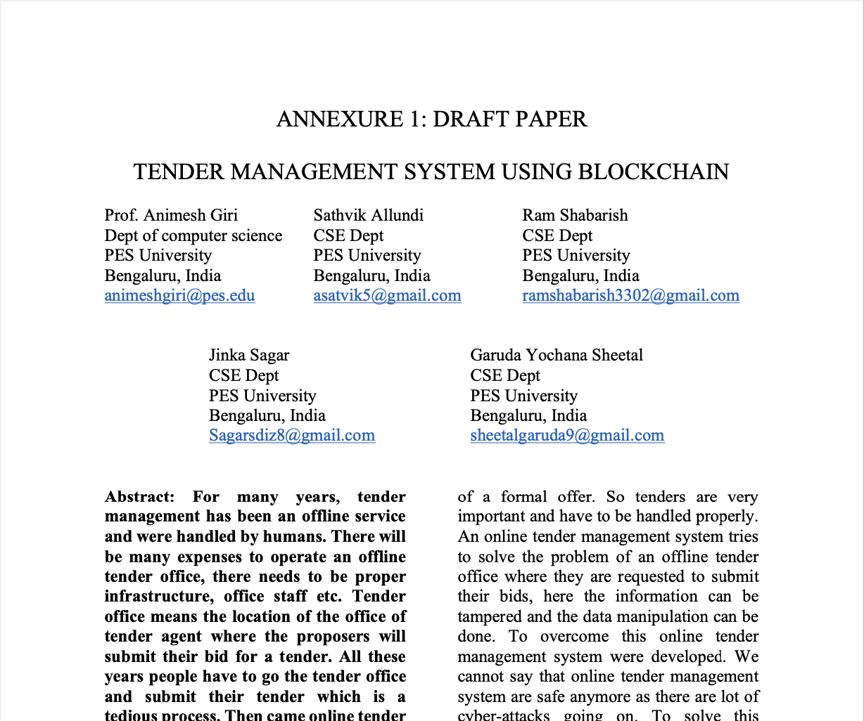

Slide 22
Lessons Learnt
Got an understanding of how blockchain works.
Understanding where and how blockchain can improve the current system
Our project can be further improved by separating data i.e, onblock and offblock

Slide 23
Conclusion and Future work
Therefore, the tender management system using blockchain provides decentralization and tamper proof data. As a tender management system needs it the most. It eliminates third party therefore only the contractor and the bidder take part in the process. The bidders can bid on the tenders they wish to bid, and they need not worry about the data being manipulated. This Tender management system using blockchain can be developed further by separating the data storage area and using the blockchain only for the purpose of verification and other security reasons. By developing more functionalities, the system will be able to replace the current tender management system.

Slide 24
References
[1] Wang, D.; Zhao, J.; Mu, C. Research on Blockchain-Based E-Bidding System Appl. Sci. 2021, 11, 4011.
[2] Andrew, B.; Christopher, B.; Thomas, P. Digital Voting with the Use of Blockchain Technology
[3] F. S. Hardwick, R. N. Akram and K. Markantonakis, "Fair and Transparent Blockchain Based Tendering Framework - A Step Towards Open Governance”
[4] Y. Goswami, A. Agrawal and A. Bhatia, "E-Governance: A Tendering Framework Using Blockchain With Active Participation of Citizens”
[5] D. Mali, D. Mogaveera, P. Kitawat and M. Jawwad, "Blockchain-based e-Tendering System"
[6] P. Manimaran and R. Dhanalakshmi, "Blockchain-Based Smart Contract for E- Bidding System"
[7] Y. -H. Chen, S. -H. Chen and I. -C. Lin, "Blockchain based smart contract for bidding system"

Slide 25
Thank You

